Slide 1
Java 102

Slide 2
Syllabus
Basic Java, cotd
Collections API
Java nio API
Using Libraries

Slide 3
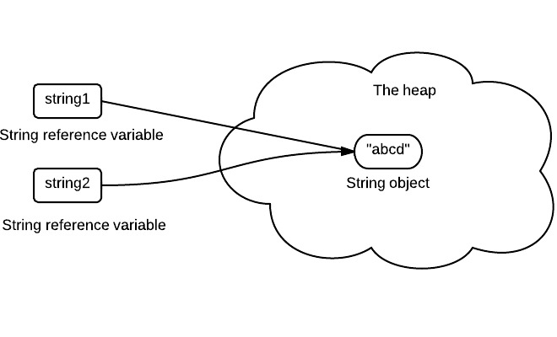
Immutable Object
An object is considered immutable if its state cannot change after it is constructed.

Slide 4
Static Keyword
static members belong to the class instead of a specific instance.
It means that only one instance of a static field exists. even if you create a million instances of the class or you don't create any. It will be shared by all instances.

Slide 5
== vs equals()
==
Only returns true if both objects are actually the same object (same location in memory)
equals()
Returns true if both objects are the same object or logically equals

Slide 6
List
A list is an ordered collection of objects. Contains index-based methods to insert and delete elements.

Slide 7
Set
A set represents a collection of unique objects. The ordering of elements in a set is irrelevant.

Slide 8
Queue
An ordered list of objects with its use limited to insert elements at the end of the list and deleting elements from the start of list i.e. it follows the FIFO or the First-In-First-Out principle.

Slide 9
Map
Represents a collection that contains key-value mappings.

Slide 10

Using java.nio to Manipulate File
Browse File
Read File
Write File

Slide 11
Using Libraries
A library is a collection of class definitions and its implementations. The main benefits of creating library is simply code reuse.

